Slide 1


Iteration Review 28
Nick Draper

Slide 2
Agenda
Release (Nick)
Python Changes past and future (Pete, Martyn)
Central Services (Pete)
VATES update (Owen)
Introduction to CPack and its implications (Russell)
Multidimensional Fitting – through an example function (Roman)
Next iteration:
  Warnings Day
  Solid Angles
  Masking tab in the instrument view
  Single crystal peak picking tool in the instrument view
  Plot and correctly regrid completed SQW data
  Move to distribtuted version control?

Slide 3
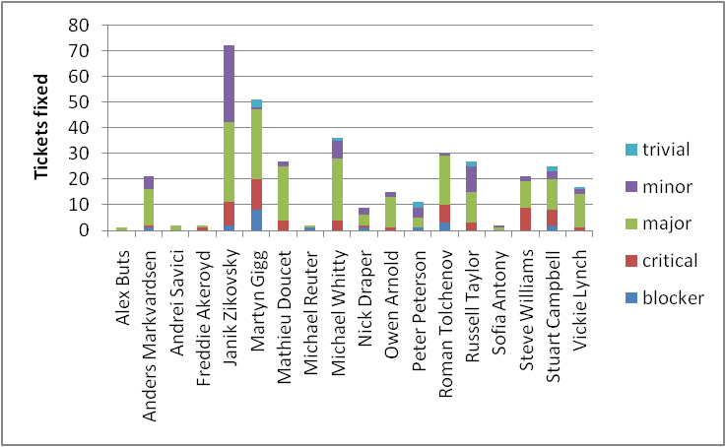
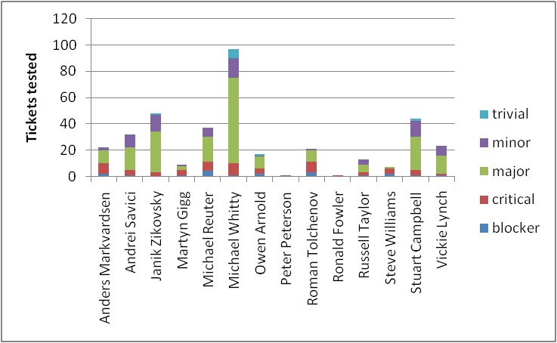
Release
Huge release
  372 tickets (296 previous)
Multiple complications
Still out on time

Slide 4
Python Changes past and future
Python 2.7 bundled with Windows
EventWorkspace and EventList exposed to python
Tweaked Reducer to fully accommodate workflow algorithms (using Inelastic as our first real example)
mantidsimple.py - Most of the functionality has been moved into MantidFramework.py. Still intending on getting rid of mantidsimple.py, but it didn't happen during the last release.
New python interface for end users (future discussing pending)

Slide 5
Central Services
UNUSED_ARG macro
  more developer friendly than "(void)arg"
Deprecation
MantidKernel/System.h
  sized integer types
ConfigService.getInstrument()
ConfigureService.getFacility().getInstrument()
Masking/grouping
Generic features of an algorithm
  respecting masks (carrying them forward as well)
  execEvent
  copied code concerning setting up output workspaces

Slide 6

VATES update

Slide 7
Introduction to CPack and its implications

Slide 8
Multidimensional Fitting – through an example function

Slide 9
Warnings Day
Was cancelled at short notice last iteration
Will now be held Monday 16th of May
  Tuesday for people who are not available Monday
Library | Developer 1 | Developer 2
Kernel | Anders
Geometry | Martyn | Janik
API | Vickie | Russell
DataObjects | Pete
DataHandling | Stuart | Steve
Algorithms | Russell | Pete
Nexus | Stuart | Steve
Crystal | Andre
CurveFitting | Anders
Icat | Russell
MatlabAPI | Steve
PythonAPI | Martyn
MDAlgorithms | Janik | Owen
MDDataObjects | Alex | Owen
MDEvents | Janik
Vates | Owen | Michael
UserAlgorithms | Andre
MantidQT | Martyn
MantidPlot | Roman

Slide 10
Solid Angles - Current
Uses triangulation of shapes.
Identifies which triangles are “pointing” at the observer.
Sums the triangles solid angles.
Very Fast
Works with all shapes
Accurate
  Apart from problems

Slide 11
Solid Angles - Problems
Problem
  Doesn’t take into account shadowing from other components
Workaround
  Make detectors very thin!
  Problem
    Not obvious you should do this!
    Doesn’t work for tubes
      Workaround
        Do not consider the end caps for Cylinders
Not Ideal

Slide 12
Solid Angle - Other approaches
Consider all triangles in the instrument
  Really Slow
Consider all triangles within a certain spherical angle of each detector
  Pretty slow
Only consider triangle from the “Primary” surface of a shape
  The surface that is most closely oriented to the observer
Other ideas?

Slide 13
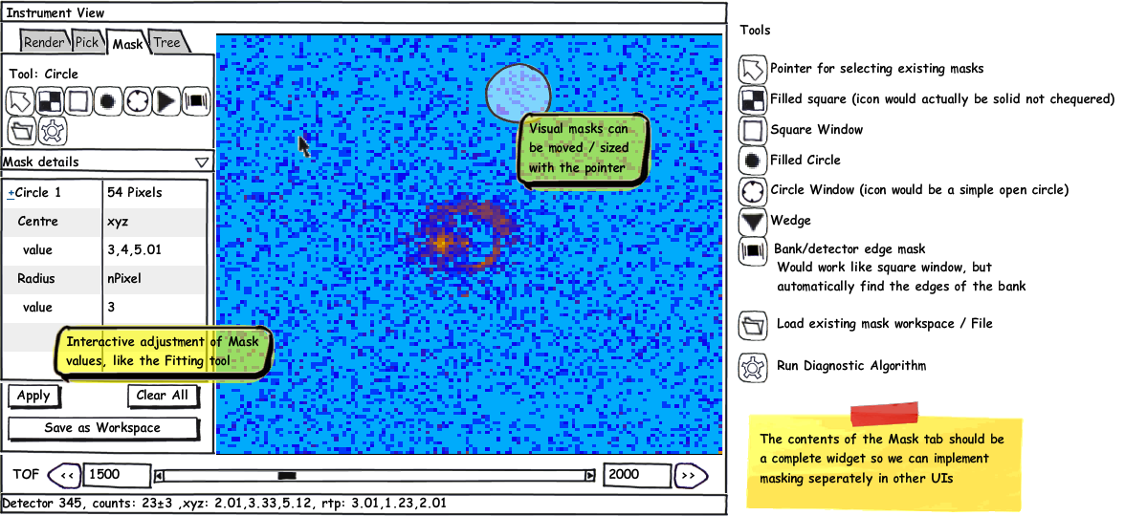
Masking Tab in the Instrument View

Slide 14
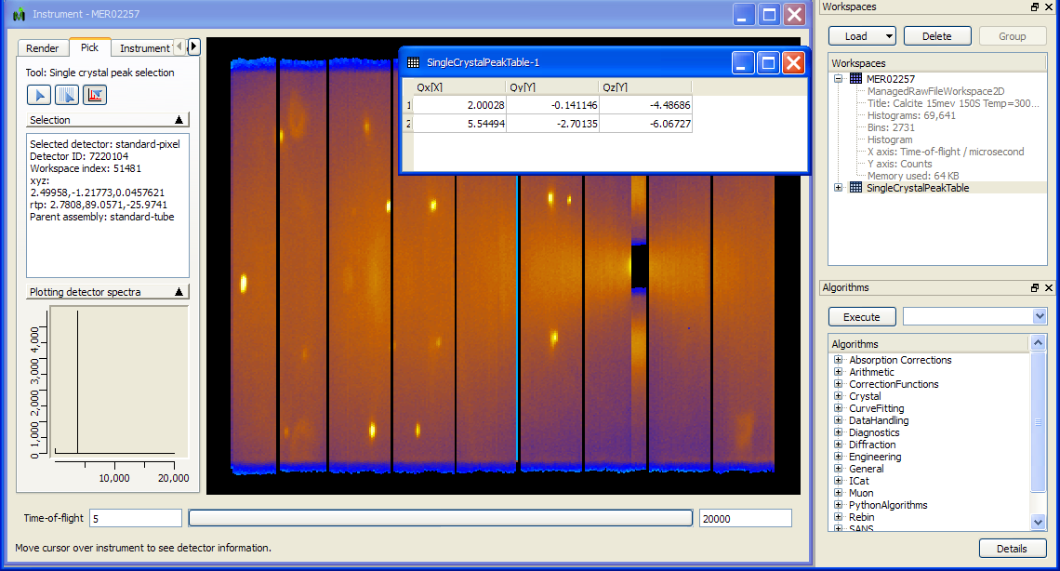
Single crystal peak picking tool in the instrument view

Slide 15
Plot and correctly regrid
SQW data
Current SQW plotting not correctly plotting pixel shape
Particularly important for small inelastic and reflectometry instruments
Current Rebinning
  only taking into account centre point of the detector
  1D at a time
Vital for refectometry and important step to supercede mSlice
Need to investigate different approaches

Slide 16

Move to distributed version control
Remote access to Shadow SVN from the US is not ideal
Shadow has had poor reliability lately
Distributed VC will allow for local hubs
Possibly an external master copy
ORNL
RAL
External Master?

